Slide 1
DS3000: BLUEBike Analysis Project
Pablo Kvitca, Griffin Milas, Hongyu Tao
Dec 08, 2019

Slide 2
Introduction - BLUEBikes
Bike-Share program
2011- Hubway system launched in July, 600 bikes & 60 Boston Stations
Since then, major expansions into multiple neighborhoods (Cambridge, Dorchester, Roxbury, etc)
Over 1,800 bikes between all stations
Goal: Predict demand of BLUEBikes based on available trip & weather data

Slide 3
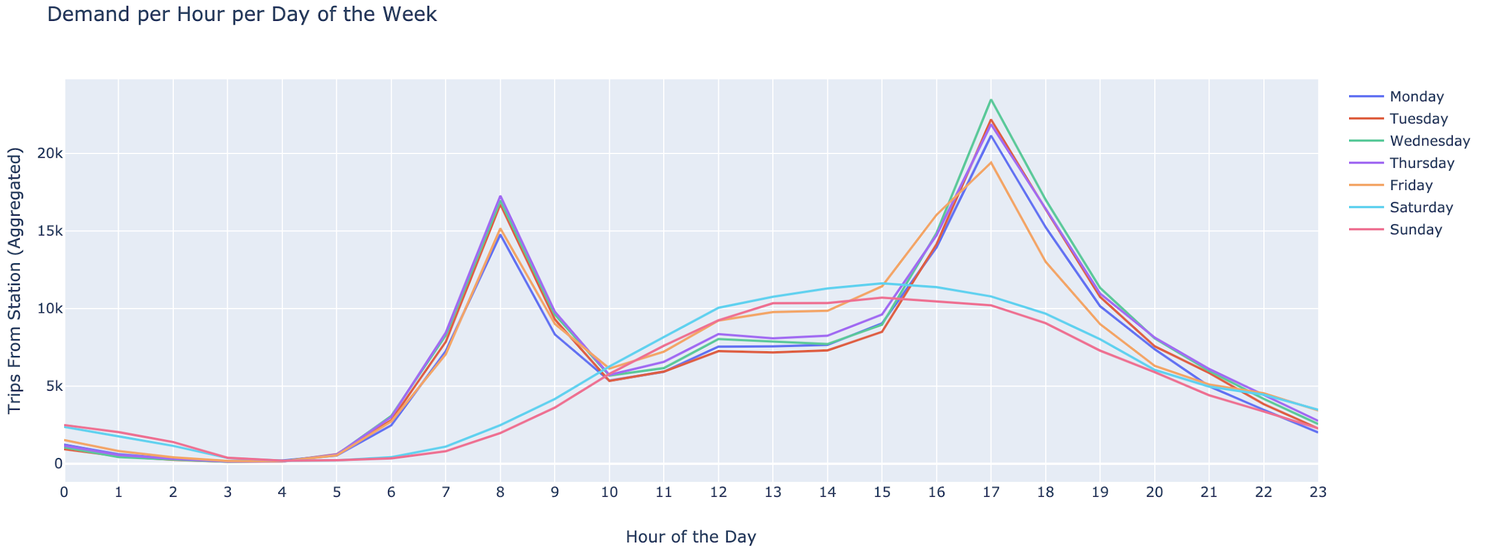
Datasets
BlueBike CSVs:
Each row = one trip
Key columns:
Start time / End time : Date & Time
Start / End Station : Lat & Long, unique name
Weather Data
Each row = one day
Key Columns:
Precipitation: Max, min, avg for day
Temperature: Max, min, avg for day
SNOW

Slide 4
Pre-Processing
First step: group trips by time chunks
Monthly, Weekly, Daily, Hourly
Aggregate all trip data during the chunk by station
Export each into a separate CSV
Next Step: Feature Engineering
From dates (timestamp), extract column for year, month, day, etc.
Extract day of week, time of day, season
Idea: Some of these will affect demand, better to extract the features explicitly from timestamp

Slide 5

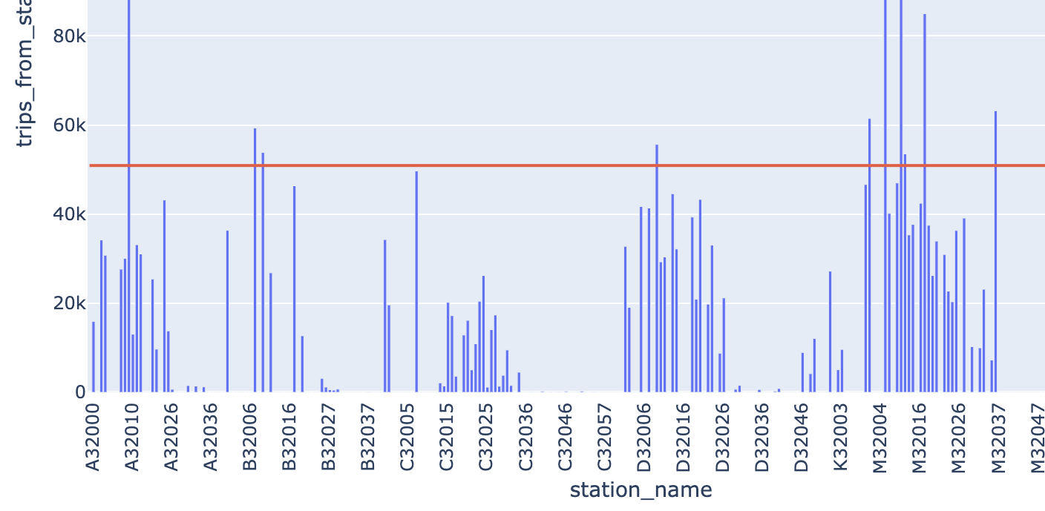
Pre-Processing: Narrowing Dataset
For hourly data, we ended up with ~9.85 million rows of data, each with 23 rows
Huge amount of computational time + effort
Decided to narrow our dataset
Realization:
According to our data, many stations had no trips to or from them
(Could be new stations, deprecated stations, or some other error)
We decided to view only stations that had more than 50,000 trips in or out
Exactly 14 stations met our criteria
We decided to focus our efforts analyzing only these stations

Slide 6
Pre-Processing: One-Hot Encoding
Categorical data needs to be reduced for machine learning algorithms
All of the features from the feature engineering would need to be one-hot encoded
Ended up transforming 23 columns into XXX columns
Final step: Dropped timestamped columns (now encoded by one-hot)

Slide 7
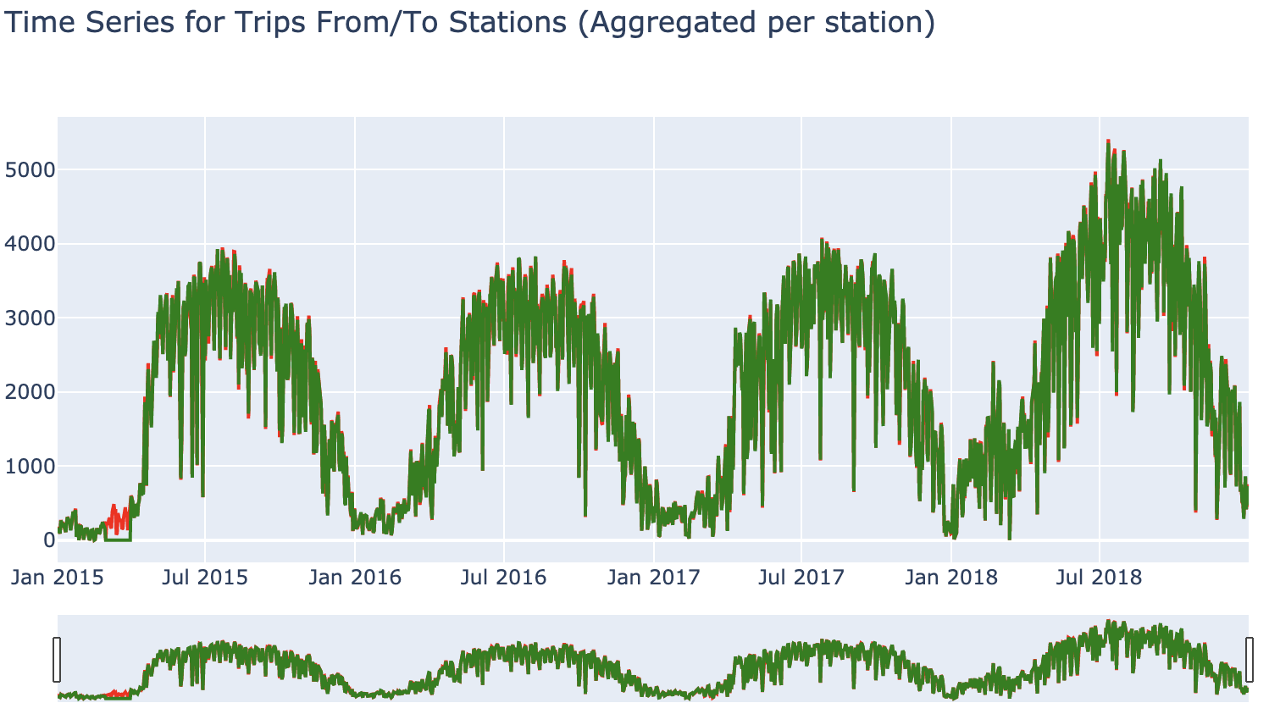
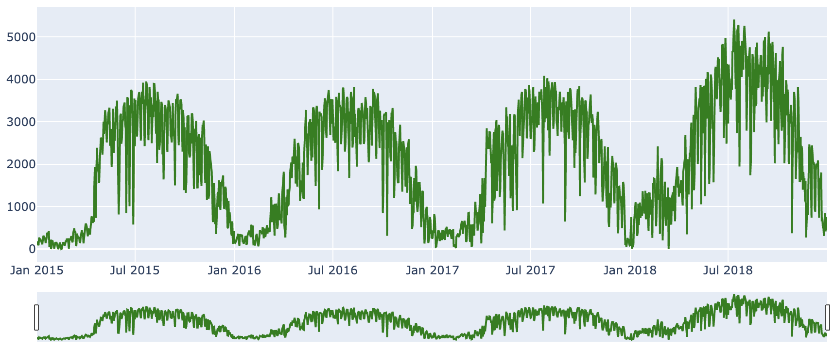
Data Visualization: trend of bike movement over time
Winter: the least used
Spring: a rapid rise
Summer: the most used
Fall: a rapid reduction
Also, the 2018 year houses more trips comparatively than any of the previous years.

Slide 8

Data Visualization: “trend” of the year over location
Station's demand was relative to major Bostonian landmarks and locations.
And it had little to do with latitude and longitude.

Slide 9
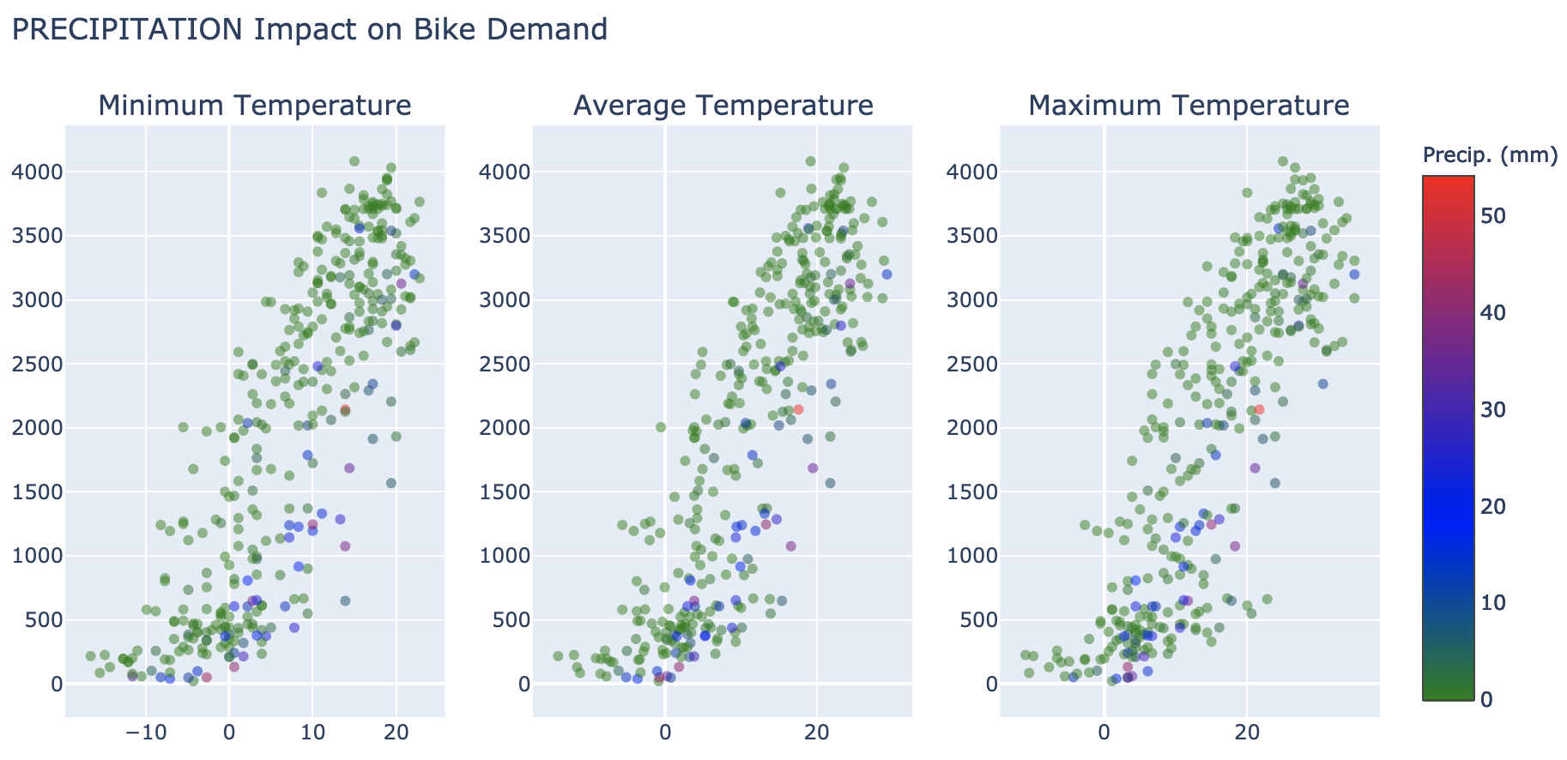
Data Visualization: Precipitation Significance
In the case of precipitation, this drop is much more drastic, since most people would not ride a bike in the cold.

Slide 10
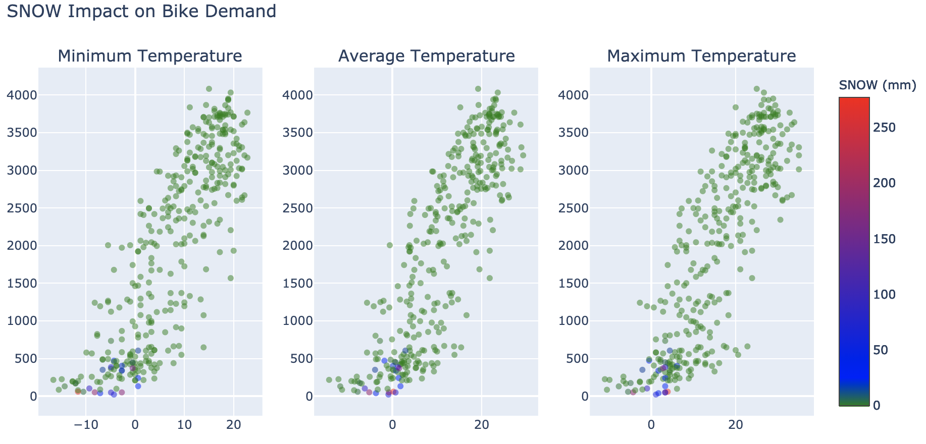
Data Visualization: Snow Significance
In the case of snow, this drop is much more drastic, since most people would not ride a bike during a storm.

Slide 11
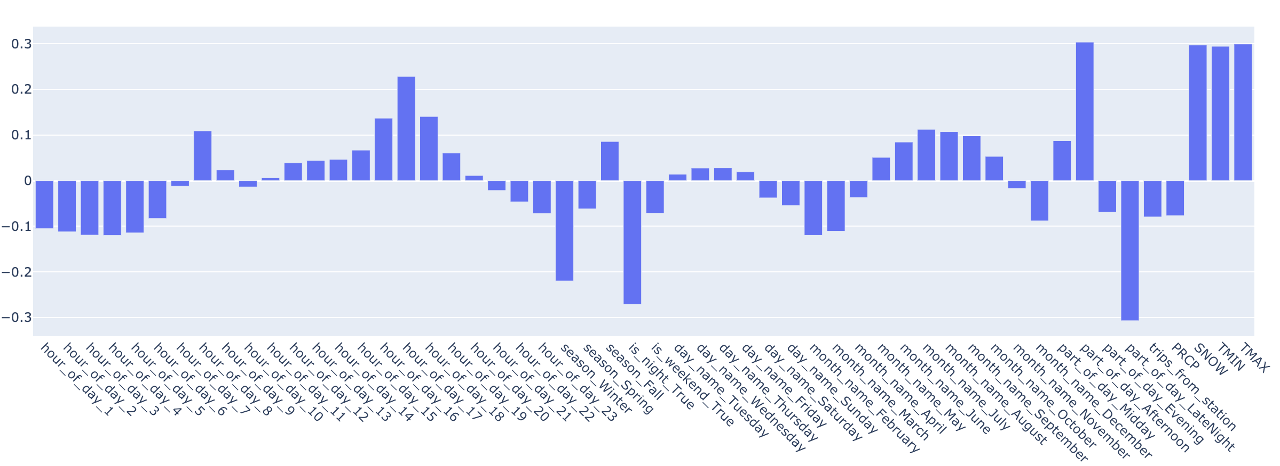
Data Visualization: variable correlation matrix
Variable Correlation Matrix
The largest positive-correlated feature is part_of_day_afternoon. Though mornings are good for weekdays, weekends do not have nearly as strong of demand. However, afternoons are consistently busy for all days of the week.
The most impactful negative-correlated features include is_night ( most people tend to not be awake at night), part_of_day_latenight (same reasoning as is_night), and season_winter (which makes sense based on our map-plot, as well as our temperature graphs).

Slide 12
Model - Building
Conclusion of data visualization: Each station has its own pattern of demand
Though there are general trends that all stations follow, prediction will be better if we train each station individually.
Process for model-building:
For each of the selected 10 stations, fit our ‘suite’ of regressors
Train and test on 70-30 training/testing split of that station’s data
Perform analytics on the aggregated test metrics (R-squared) to determine best regressor(s)

Slide 13
Model - Regressors
Linear
Fits a linear model with a coefficient for each feature
Fast and simple, likely not very accurate
R-Squared for training set: 0.366
R-Squared for testing set: 0.365
Ridge
Linear regression that uses L2 regularization (all coefficients are shrunk by same factor, none are eliminated)
Good at dealing with multicollinearity in data, will not eliminate parameters
R-Squared for training set: 0.366
R-Squared for testing set: 0.365

Slide 14
Model - Regressors
Decision Tree
Expected to perform well due to its multi-tier decision making process
R-Squared for training set: 0.709
R-Squared for testing set: 0.593
Random Forest
Fits many decision trees onto the data, averaging them to produce an output
R-Squared for training set: 0.937
R-Squared for testing set: 0.634

Slide 15
Model - Regressors
Histogram-based Gradient Boosting
GB builds an additive model in a forward stage-wise fashion; it allows for the optimization of arbitrary differentiable loss functions.
R-Squared for training set: 0.708
R-Squared for testing set: 0.682
Extreme-based Gradient Boosting
XGBoost is an optimized distributed gradient boosting library designed to be highly efficient, flexible and portable.
R-Squared for training set: 0.710
R-Squared for testing set: 0.695

Slide 16
Model Optimization (XGBoost)
Before tuning:
R-Squared for testing set: 0.695
After tuning:
R-Squared for testing set: 0.697
We fit and tested a variety of regression algorithms onto the data, finding that our model was fairly accurate at predicting data within the 2015-2018 range (R-Squared = 0.697), but less accurate at forecasting future (2019) data (R-Squared = 0.486).

Slide 17
Conclusion
Our model does not generalize to future years with good results, we believe finding better relationships is possible and might improve this results. Future work on this subject could look into analysis on incoming trips instead of outgoing ones.
In addition, utilizing the entire dataset of stations could yield interesting results (though would take significantly more computational time and effort). Work can also be done to improve the model's forecasting abilities, such as supplying the model with more information about the expected demand variation for the year of forecasting.

